Slide 1
DSL productization
Annuparna Ganguly
12 – 05 - 2025

Slide 2
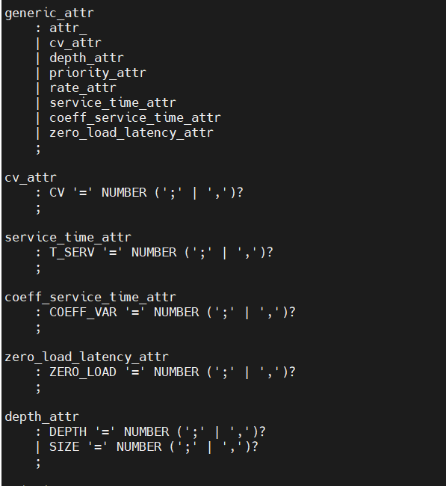
Newly added Attributes in grammar file DOT.g4
node_stmt: node_id node_attr_list;
node_attr_list : ('[' generic_attr* type_attr generic_attr* ']’)+ ;
generic_attr
: attr_
| cv_attr
| depth_attr
| priority_attr
| rate_attr
| service_time_attr
| coeff_service_time_attr
| zero_load_latency_attr ;
Example
SR1 [ type = server, t_serv = 1.0, coeff_var = 0.0 ]

Slide 3


Proposed Idea for DSL productization
Type Based checking / validation
type attributes defines the role of the node(source,queue, etc.) regardless of node name.
Each type as a required and exclusive set of valid attributes. If extra or wrong ones are given, a compile-time error will be raised.
Type=source
Example:
injector1 [ type=source, rate=0.2, cv=0.85 ]
F2 [ type=source, rate=0.04, cv=0.96 ]
F3 [type=source, size=4 ]
Rate=?
cv=?

Slide 4
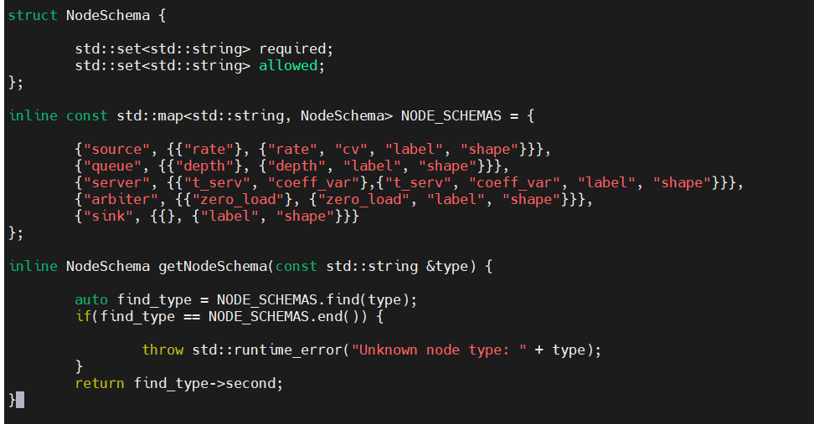
Type based schema declaration
File path: dsl/include/defines.h
Define which attributes are required for each node type.
Define which attributes are allowed for each node type
getNodeSchema() will return required and allowed attributes based on type.
Example:
F1 [ label=“ “, type= source, rate= ]
F2 [ label=“ “, type= source, rate= , cv = “ “ ]
Q1[ label=“ “, type= queue ,depth= ]

Slide 5
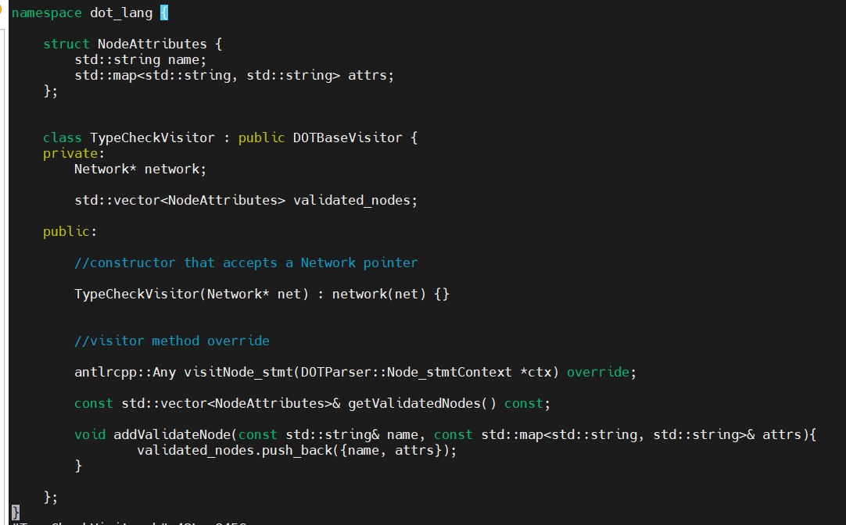
Type based schema Validation
File Path:
dsl/include/TypeCheckVisitor.h
dsl/src/TypeCheckVisitor.cpp
This will do
Normalize attribute keys to lowercase
Ensure type attribute is present
Validate required attributes based on the type
Reject unknown attributes.
Provide default “cv” if the user omits it.
If valid, then add it to addValidateNode list addValidateNode(node_name,attrs);
Q1 [type=queue, depth=10];
queue2[type=queue, depth=5];
queue3 [type=queue]; //

Slide 6
DSL Modularization
Replace main.hpp file which was containg all Primitive class
Inside dot_lang namespace
Node is a class for all vertices which has three members
id
Type
Name
Junc is class, stands for junction which connects two Primitives
Primitive class is inherited from Node class.
RoundRobin class and Priority class is inherited from Arbiter class.
include folder contains all .h files of this module.
src folder contains all .cpp files of this module.
Node
Primitive
Injector
Queue
Junc
Arbiter
RoundRobin
Priority
Server
Sink
dot_lang

Slide 7
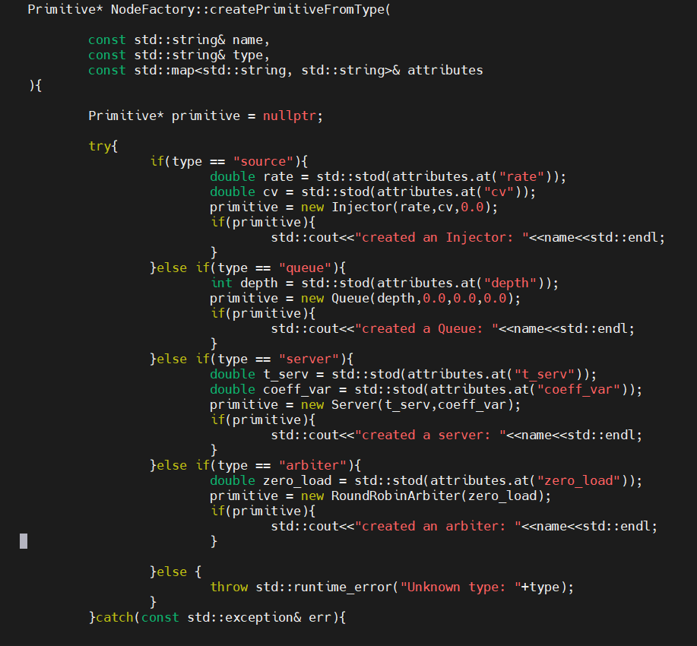

Creating object of existing class
File Path : dsl/src/node_factory.cpp
Declares new method createPrimitiveFromType() which will
Will create object of class based on the type.
return Primitive*
Working Flow
Test_graph.dot
ANTLR4 Lexer/Parser Parse Tree
TypeCheckVisitor Validates Types/Attrs
createPrimitiveFromType create object
Builds Network (Injector, Queue, etc.)

Slide 8
Future work
Edge Validation
Generate goldenLog file

